Slide 1
Attendance
Board
Manager
Homework
Checker
Line Manager
Teacher Helper

Slide 2
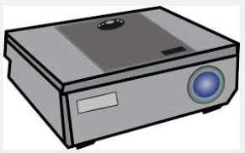
Datashow
Manager
Supplies
Checker

Slide 3
Group
2
Group
3
Group
4
Group
5
Group
1

