Slide 1
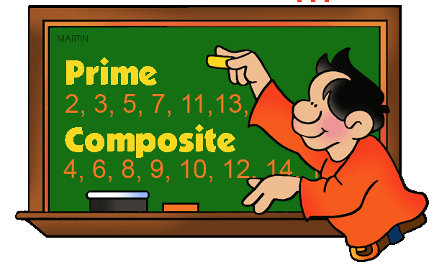
Prime Numbers

Slide 2
Multiples
Factors
2
12
5
20
7
21
10
15
3
11

Slide 3
Prime Numbers
These are numbers that have only two factors : themselves and one.
An example of Prime Numbers would be
3 = 1 , 3
7 = 1 , 7
11 = 1, 11

Slide 4
Composite Number
Has more than 2 factors

Slide 5
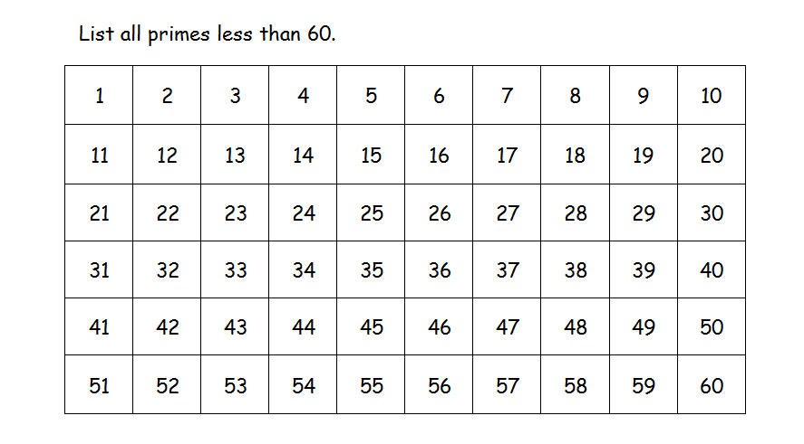
Follow these steps to find the prime numbers
Cross out 1 as it is not a prime .
Circle the prime number 2 then cross out all multiple of 2.
Circle the next number, 3. This is a prime .now cross out all multiple of 3.
Circle the next number, 5. This is a prime .now cross out all multiple of 5.
Continue using this method until all composite numbers have been crossed out.

Slide 7
Review
Can you tell if these numbers are prime?
110
21
29
7
45
15
4
37
23
31
49

Slide 8
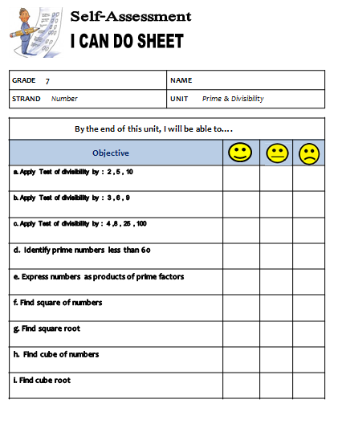
I CAN DO

Slide 9
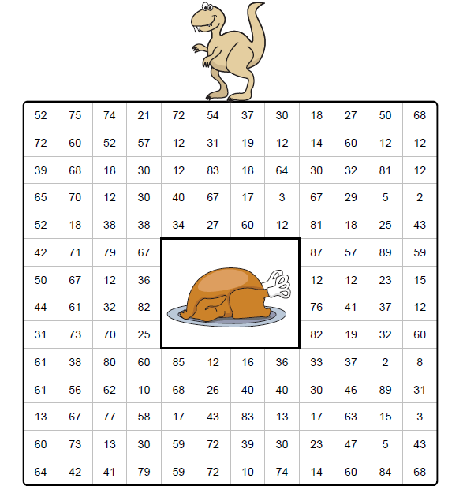

Slide 10
