Slide 1
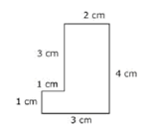
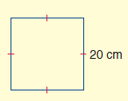
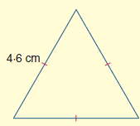
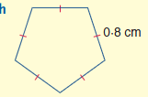
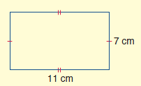
Perimeter
Part 1 Find the Perimeter.
a)
b)
c)
P=
P=
P=
Part 2 Find the Perimeter.
a)
b)
P=
P=
c)
d)
P=
P=

