Slide 1
Quiz

Slide 2
Corresponding
Angles

Slide 3
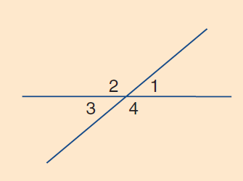
Warm Up Questions
Which angle is equal to angle 1?
Which angle is equal to angle 2?
What can you say about the sizes of angles 2 a?

Slide 4
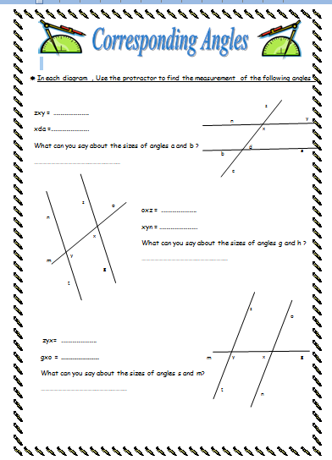
Use your protractor to complete the worksheet

Slide 5
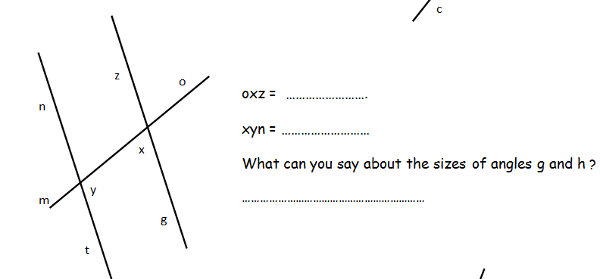
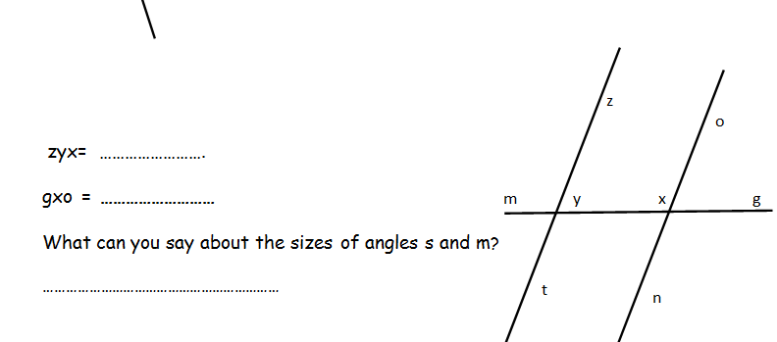

Slide 6
Corresponding Angles
When 2 parallel lines are cut by transversal
4 pairs of equal corresponding angle are formed
l
l

Slide 7
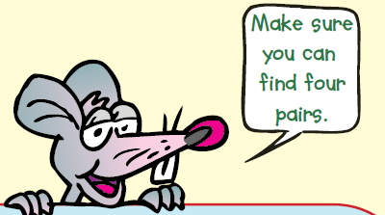

Slide 8
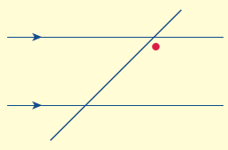
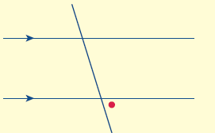
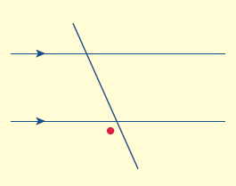
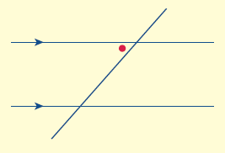
Examples

Slide 9
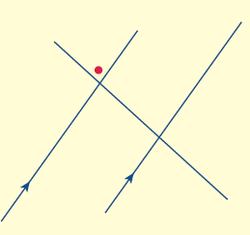
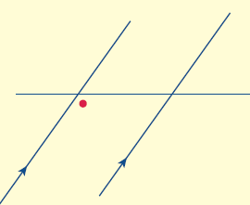
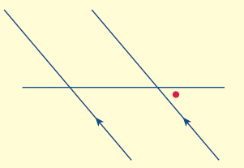
Examples

Slide 10
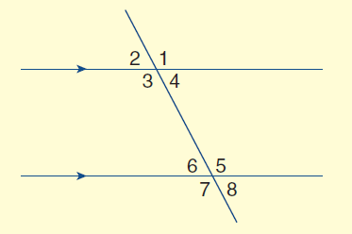
On your whiteboard

Slide 11
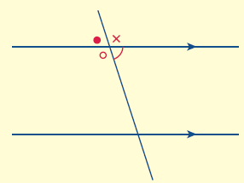
On your whiteboard

Slide 12
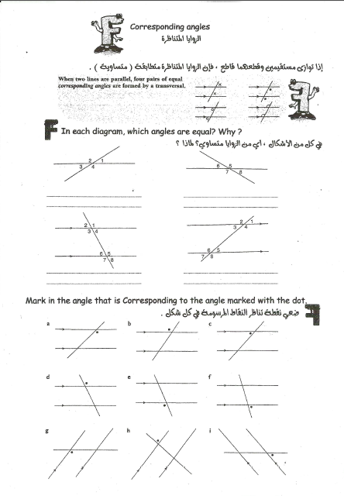
Complete your Worksheet

Slide 13
What did we learn today

Slide 14
Quiz

Slide 15
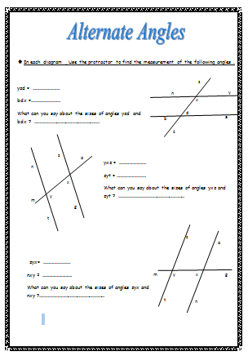
In Pairs
Use your Protractor to complete your Worksheet

Slide 16
Alternate Angles
When 2 parallel lines are cut by transversal
2 pairs of equal alternate angles are formed
l
l

Slide 17
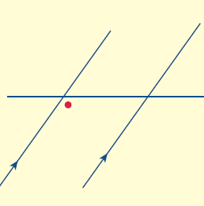
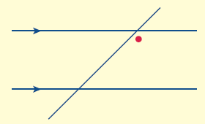
Examples

Slide 18
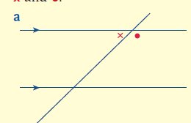
On your whiteboard

Slide 19
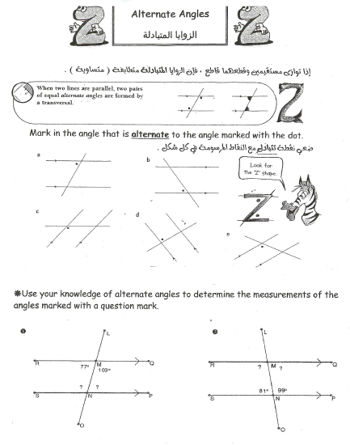
Complete your worksheet

Slide 20
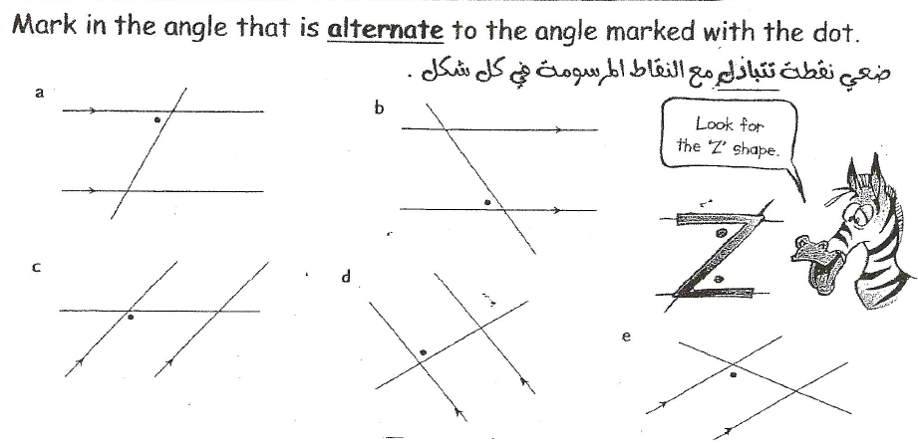
Lets discuss together

Slide 21
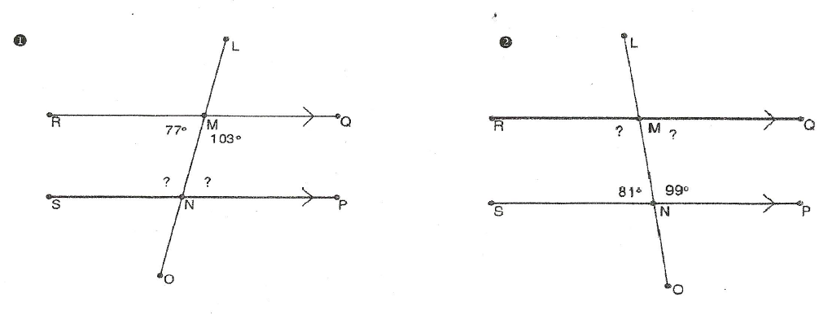

Slide 22
What did we learn today

Slide 23
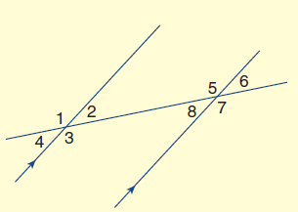
Warm up questions
In the diagram:
Which angle is alternate to angle 3?
Which angle is alternate to angle 2?
Which angle is corresponding to angle 1?
Which angle is corresponding to angle 7?

Slide 24
Lets remember together corresponding angle
y
y

Slide 25
Lets remember together Alternate angle
y
y

Slide 26
Use your whiteboards
b
c
1
2
z
3
4
a
5
6
k
7
8
h

Slide 27
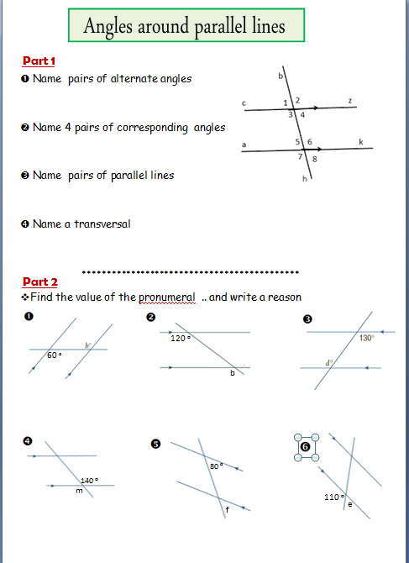
Complete your worksheet
Part 1

Slide 28
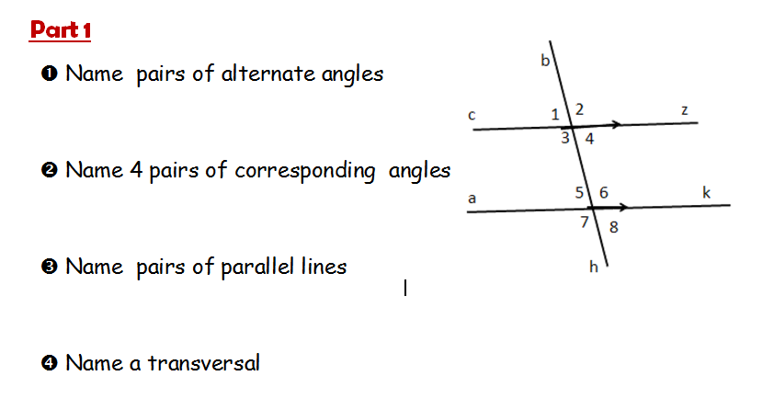
Lets Discuss together

Slide 29
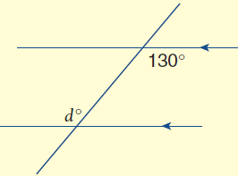
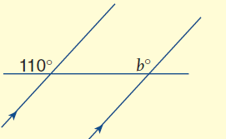
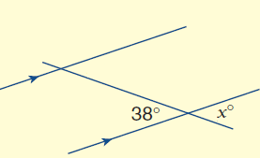
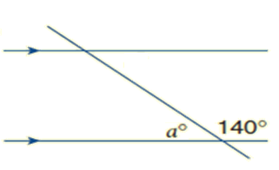
Find the missing angle ..write a reason

Slide 30
Find the missing angle

Slide 31
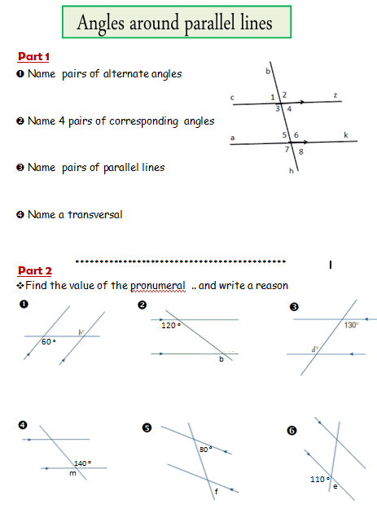
Complete your worksheet
Part 2

Slide 32
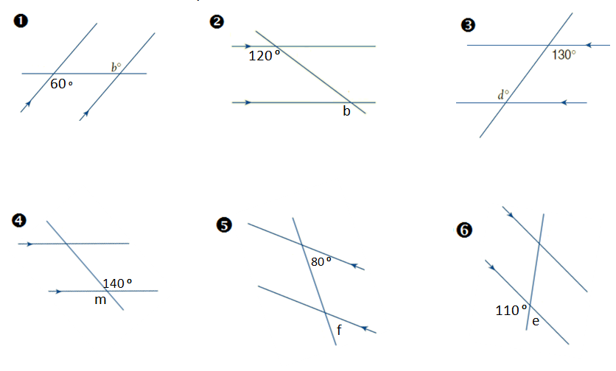
Lets Discuss together

Slide 33
Homework

