Slide 1
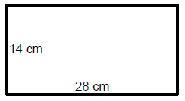
Area
Find the area of the following shapes
A = s  s
= 12  12
= 144 cm²
A = l  w
= 28  14
= 392 cm²
A = l  w
= 24  8
= 192 cm²
A = s  s
= 5  5
=25 cm²
A = s  s
= 8  8
= 64 cm²
A = l  w
= 8  11
= 88 cm²

