Slide 1
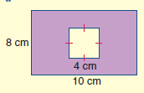
Area of shaded part
⬄Find area of shaded part
◆
❖
4 cm
5 cm
7 cm
3 cm
2 cm
10 cm
⬥

Slide 2
Find the area of these figures…
Find the area of these figures…

