Slide 1
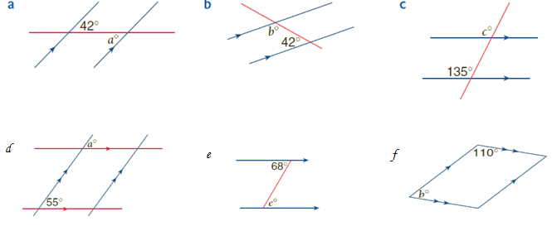
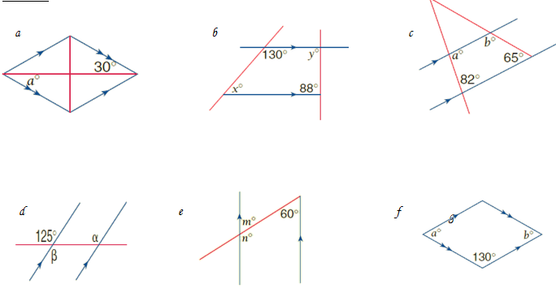
Angles Around Parallel Lines
Find the value of the pronumeral..
Give a reason for each answer
Part 1
Part 2

