Slide 1
Quiz

Slide 2
The Angles
Come and meet the Angle family...

Slide 3
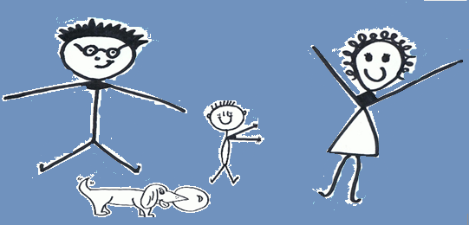
Hi ..
We Are the Angles
“we’re one family, but all
very different,
so let us tell you a bit about ourselves!”

Slide 4
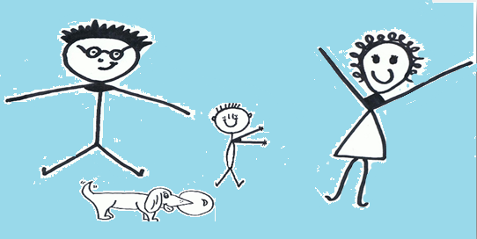
Hi ..
We Are the Angles
“we’re one family, but all
very different,
so let us tell you a bit about ourselves!”

Slide 5
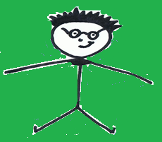
This is Obtuse.
He’s the husband of the family.
He’s bigger than Right and Acute .
He always measures between 90° and 180°
(depending on how much dinner he’s eaten!)
Mr. Obtuse

Slide 6
Obtuse
Examples

Slide 7
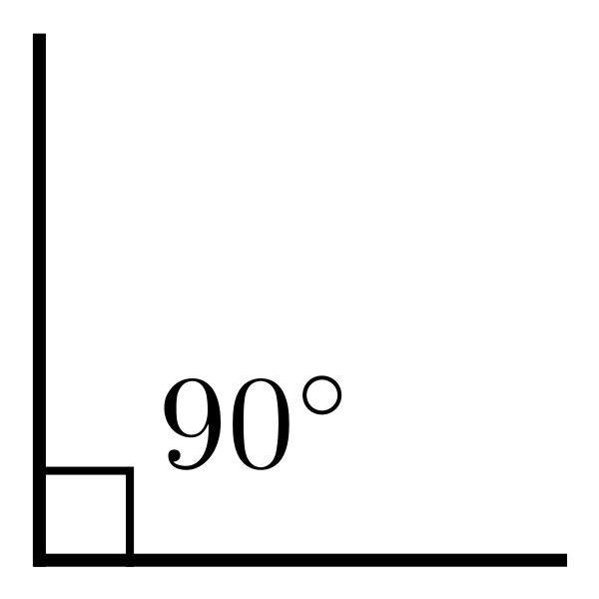
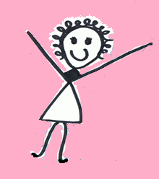
Mrs. Right
This is me.
I’m Mrs. Right Angle.
I always measure 90°,
My favourite shape is a square,

Slide 8
Baby Acute
This is baby Acute angle. Isn’t he cute?!
He loves a hug, and always has his arms out!
He’s the smallest of the family,
measuring less than 90°.

Slide 9
Acute
Examples

Slide 10
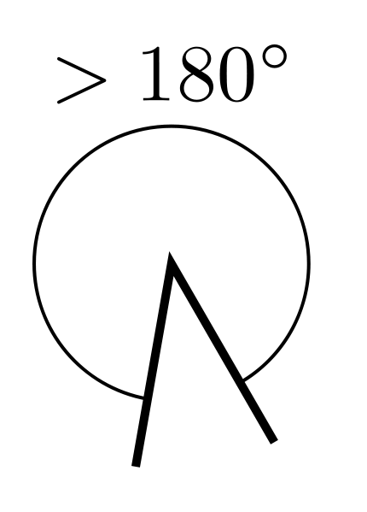
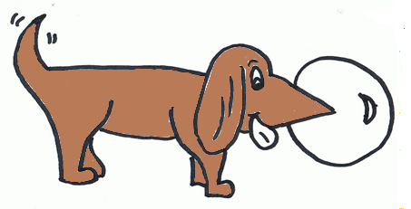
Reflex
This is dog, Reflex
. He’s always outside. He measures between 180°, and 360 °!
So he’s definitely the biggest angle.

Slide 11
Examples

Slide 12
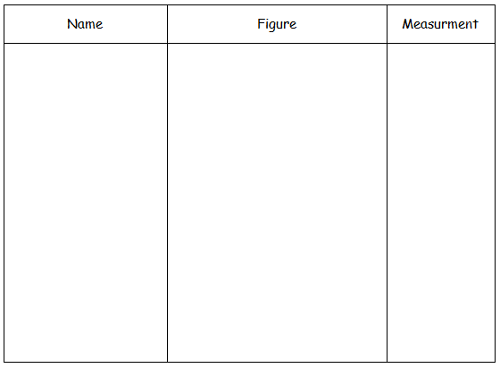
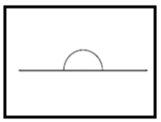
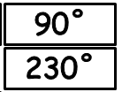
Group Activity

Slide 13
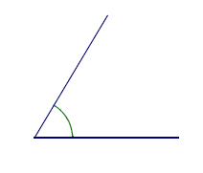
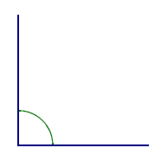
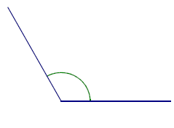
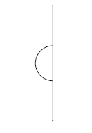
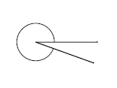
Name | Figure | Measurment
Acute
72˚
Right
90˚
Obtuse
140˚
180˚
Straight
Reflex
230˚

Slide 14
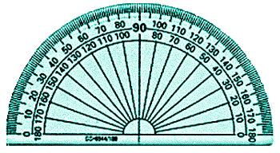
Protractor

Slide 16
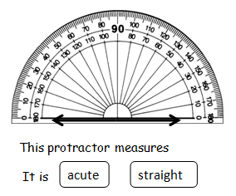
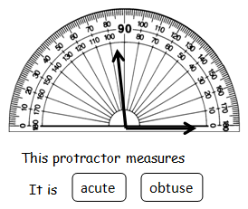
On your whiteboard

Slide 17
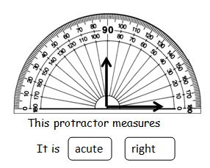
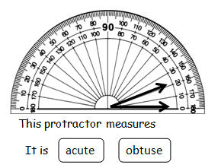
On your whiteboard

Slide 18
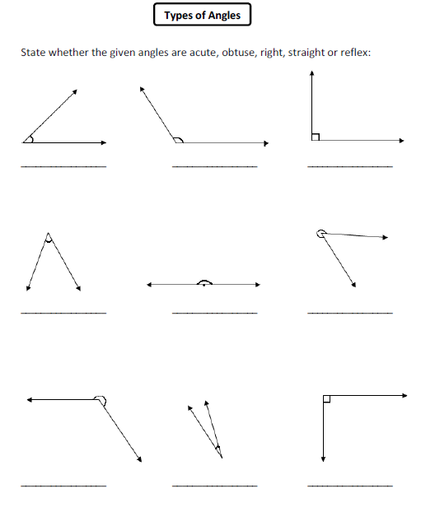
Complete
your
Worksheet

Slide 19
So, now you’ve met us, let’s see how well you know us...

Slide 20
Who am I?
I always measure less than 90°
I’m the smallest angle
I’m very cute!

Slide 21
I’m....
Baby Acute

Slide 22
Who am I?
I’m always outside
I’m the biggest angle
I can measure between 180° and 360°

Slide 23
I’m....
Reflex

Slide 24
Who am I?
I always measure between 90° and 180 °
I’m always inside
I’m bigger than Right and Acute

Slide 25
I’m....
Mr. Obtuse

Slide 26
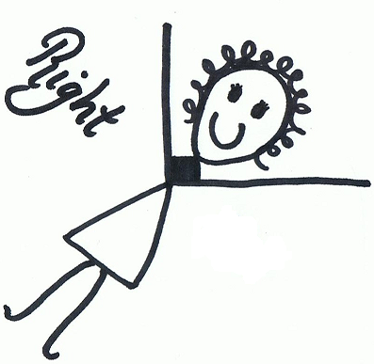
Who’s left?

